Slide 1

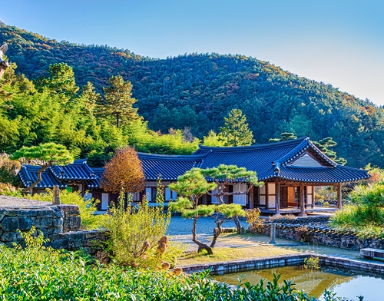
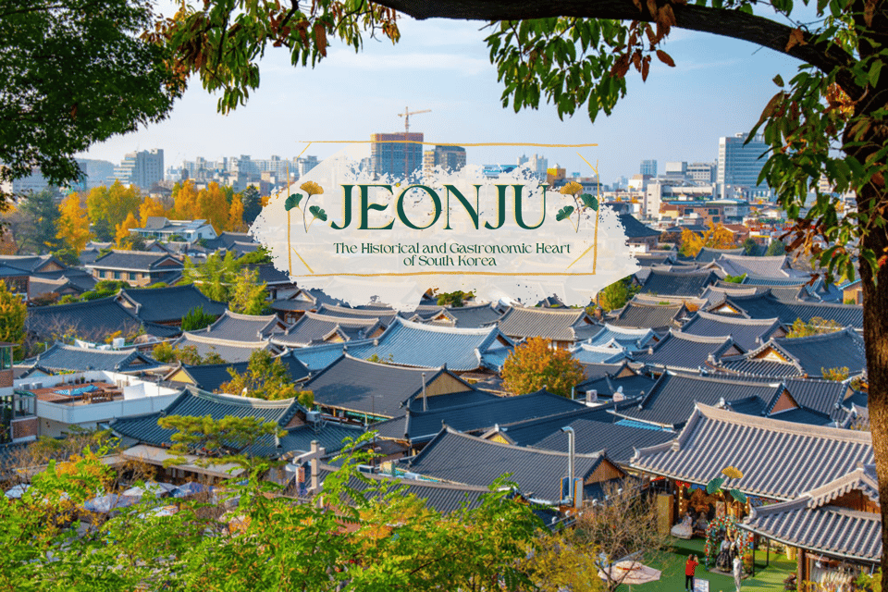
Cultural Activities 2026
Field Trip to Jeonju (July 9 - 10)
Jeonju is a city that preserves Korean tradition and history, located in the heart of Jeollabu-do province.
The Jeonju Hanok Village is a place where you can experience traditional Korean architecture and culture, with many Hanok (traditional Korean houses) preserved.
In the Hanok Village, you can try wearing Hanbok and trying Korean traditional cultural activities.
Notes:
[Slide 12: Jeonju Field Trip]
"Our field trip to Jeonju is a chance to explore Korea’s traditional culture. You’ll visit the Hanok Village, where you can try on Hanbok (traditional Korean clothing) and experience various cultural activities."

Slide 2


Jeonju Field Trip Itinerary (Thursday, July 9)
Time | Location | Schedule
07:50 AM ~ 08:00 AM | UOS Campus, In front of Main Auditorium (#27) | Attendance Check
08:00 AM ~ 11:30 AM | Express Bus | Departure for Jeonju
11:30 AM ~ 4:00 PM | Jeonju | • Bibimbap Cooking Experience (Traditional Korean Cuisine) • Lunch: Bibimbap • Guided Tour of Jeonju Hanok Village • Hanbok Experience (Traditional Korean Attire)
4:00 PM ~ 4:30 PM | Express Bus | Departure for Wanju
4:30 PM ~ 8:00 PM | Wanju | • Traditional Hanji Paper Experience • Hanji Paper & Craft-Making Workshop • Dinner
8:30 PM | Jeonju Gloster Hotel | Hotel Check-in and Rest
Notes:
[Slide 13-14: Program Schedule]
"The full schedule of the program will be posted on the website later, so please refer to it for more details.“
Hotel: 2 students per room

Slide 3
Jeonju Field Trip Itinerary (Friday, July 10)
Time | Location | Schedule
07:00 AM ~ 08:00 AM | Jeonju Gloster Hotel | Wake-up Call & Breakfast (Hotel Buffet)
09:30 AM ~ 10:10 AM | Express Bus | Departure for Geumsansa Temple
10:10 AM ~ 11:30 AM | Geumsansa Temple | Visit one of Korea's most renowned Buddhist temples • Explore the temple grounds and historic cultural heritage sites • Mireukjeon Hall (National Treasure No. 62) • Ten designated Treasures
11:30 AM ~ 12:00 PM | Express Bus | Departure for Lunch
12:00 PM ~ 1:20 PM | Restaurant | Lunch: Shabu-Shabu Buffet
1:20 PM ~ 5:00 PM | Express Bus | Return to the University of Seoul
Notes:
[Slide 13-14: Program Schedule]
"The full schedule of the program will be posted on the website later, so please refer to it for more details."

